Slide 1

Introduction to Clinical Pharmacology Chapter 25 Cholinergic Drugs

Slide 2
Learning Objectives
Discuss important aspects of the parasympathetic nervous system.
Explain the uses, drug actions, general adverse reactions, contraindications, precautions, and interactions of cholinergic drugs.
Distinguish important preadministration and ongoing assessment activities the nurse should perform on the client taking a cholinergic drug.
List nursing diagnoses particular to a client taking a cholinergic drug.
Examine ways to promote an optimal response to therapy, how to manage common adverse reactions, and important points to keep in mind when educating the client about the use of cholinergic drugs.

Slide 3
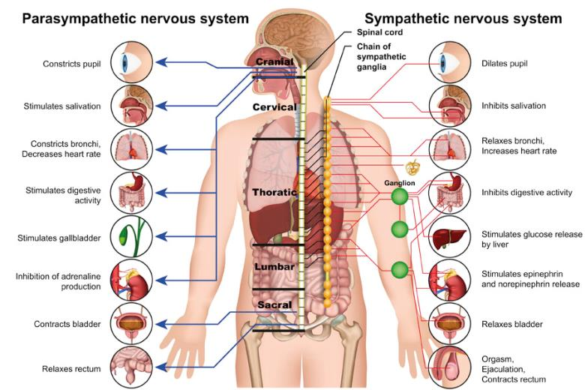
Autonomic Nervous System
Division of the peripheral nervous system concerned with the functions essential to life of an organism and not consciously controlled (e.g., blood pressure, heart rate, and gastrointestinal activity)
Divided into two branches:
Sympathetic
Parasympathetic

Slide 4
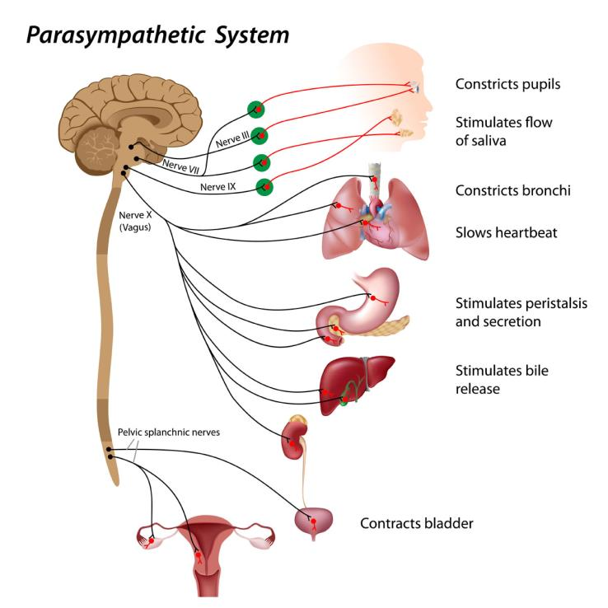
Parasympathetic Nervous System #1
Opposite reactions of sympathetic nervous system
Rest and digest
Acetylcholine (Ach) is the neurotransmitter of the parasympathetic branch of the autonomic nervous system

Slide 5
Parasympathetic Nervous System #2
Muscarinic receptors: stimulate smooth muscle
Nicotinic receptors: stimulate skeletal muscle

Slide 6
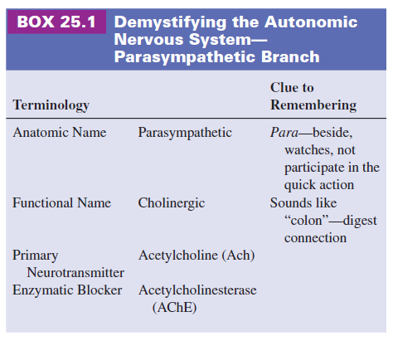
Cholinergic Drugs—Actions
Mimic the activity of the parasympathetic nervous system.
Acetylcholinesterase (AChE) is and enzyme that can inactivate the neurotransmitter acetylcholine (Ach)
Direct-acting versus indirect-acting

Slide 7

Pharmacology in Practice Exercise #1
Which of the following is he substance responsible for the transmission of nerve impulses across the parasympathetic nervous system?
Acetylcholine
Norepinephrine
Dopamine
Acetylcholinesterase

Slide 8
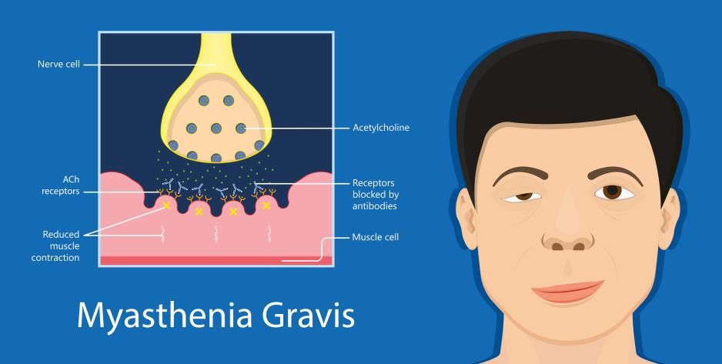
Cholinergic Drugs—Uses
Urinary retention
Neurogenic bladder when retention is an issue
Myasthenia gravis for symptom management

Slide 9

Cholinergic Drugs—Adverse Reactions
General Adverse Reactions:
Nausea, diarrhea, abdominal cramping
Salivation
Flushing of the skin
Cardiac arrhythmias
Muscle weakness

Slide 10

Cholinergic Drugs—Contraindications
Contraindicated in clients with:
known hypersensitivity to the drugs
asthma
peptic ulcer disease
coronary artery disease
hypothyroidism
secondary glaucoma, iritis, corneal abrasion, or acute inflammatory disease of the eye (ophthalmic cholinergic preparations)

Slide 11
Cholinergic Drugs—Precautions
Use cautiously in clients with:
hypertension
epilepsy
cardiac arrhythmias
bradycardia
recent coronary occlusion
megacolon
pregnancy (pregnancy category C) or lactation
use cautiously with children

Slide 12
Cholinergic Drugs—Interactions
Interacting Drug | Common Use | Effect of Interaction
Aminoglycoside antibiotics | Anti-infective agent | Increased neuromuscular blocking effect
Corticosteroids | Treatment of inflammatory/respiratory problems | Decreased effect of the cholinergic
Other cholinergics | Treatment of urinary retention or myasthenia gravis | Synergistic effect, greater risk of toxicity. Antidote is atropine.

Slide 13

Nursing Process—Client Receiving a Cholinergic Drug #1
Preadministration Assessment
Prior to administration for urinary retention.
Objective Data
General observation and palpation of abdomen, swelling over the pelvis
Bladder scanning measurement of residual urine
Vital signs
Renal function tests
Urinalys

Slide 14

Nursing Process—Client Receiving a Cholinergic Drug #2
Preadministration Assessment (continued)
Prior to administration for urinary retention.
Subjective Data
Client’s description of retention, pain, pressure, incontinence
Type and duration of symptoms including bowel
Drug and surgical history
Remedies attempted before seeking care

Slide 15
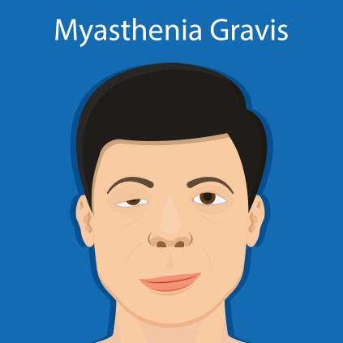
Nursing Process—Client Receiving a Cholinergic Drug #3
Preadministration Assessment
Prior to administration for Myasthenia Gravis.
Objective Data
Complete neurological assessment
Interdisciplinary assessments with speech or occupational therapy for signs of:
Muscle weakness
Inability to chew and swallow
Drooping of eyelids
Difficulty breathing
Extreme fatigue
Inability to perform repetitive movements

Slide 16

Nursing Process—Client Receiving a Cholinergic Drug #4
Preadministration Assessment (continued)
Prior to administration for Myasthenia Gravis.
Subjective Data
Client’s description of muscle weakness symptoms
Drug and surgical history
Remedies attempted before seeking care

Slide 17
Pharmacology in Practice Exercise #2
A primary health care provider has prescribed bethanechol to treat a client for acute urinary retention. What should the nurse check for in the client before the administration of bethanechol?
Tachyarrhythmias
Myocardial infarction
Coronary occlusion
Fecal contents in the large intestine

Slide 18

Nursing Process—Client Receiving a Cholinergic Drug #5
Ongoing Assessment—Cholinergic Crisis
Monitor for drug toxicity or cholinergic crisis
Signs and symptoms of cholinergic crisis: severe abdominal cramping, diarrhea, excessive salivation, muscle weakness, rigidity and spasm, and clenching of the jaw

Slide 19

Nursing Process—Client Receiving a Cholinergic Drug #6
Ongoing Assessment—Urinary Retention
Measuring and documenting fluid intake and output
Palpate the bladder to determine size or use bladder scanner if urinary output is low or client fails to void
Notify the primary health care provider the amount of residual urine and if client is unable to void after drug administration

Slide 20

Nursing Process—Client Receiving a Cholinergic Drug #7
Ongoing Assessment—Myasthenia Gravis
Document an increase in symptoms or adverse drug reactions
Monitor symptoms of myasthenia gravis before and after each drug dose
Document the symptoms and the client’s response or lack of response to drug therapy

Slide 21

Nursing Process—Client Receiving a Cholinergic Drug #8
Nursing Diagnosis
Diarrhea related to adverse drug reaction

Slide 22
Nursing Process—Client Receiving a Cholinergic Drug #9
Planning
Expected client outcomes depend on the reason for administration of the cholinergic drug but may include:
Optimal response to therapy
Management of adverse drug reactions
Confidence in an understanding of the prescribed medication regimen

Slide 23
Nursing Process—Client Receiving a Cholinergic Drug #10
Implementation
Promoting Optimal Response to Therapy
Urinary retention: place call light, urinal, or bedpan near client after administration of drug; voiding occurs after 5 to 15 minutes of subcutaneous drug and after 30 to 90 minutes of oral drug
Myasthenia gravis: drug dosing needs to be changed frequently; provider may order sustained release tablets rather than dosing every 2 to 4 hours; observe the client closely for drug overdosage or underdosage

Slide 24

Nursing Process—Client Receiving a Cholinergic Drug #11
Implementation
Monitoring and Managing Client Needs
Diarrhea
Educate the client about the side effects of excessive salivation, abdominal cramping, flatus, and diarrhea; tolerance usually develops in a few weeks
Provide appropriate toileting facilities (e.g., bedpan or commode)
Encourage client to ambulate to pass flatus

Slide 25

Nursing Process—Client Receiving a Cholinergic Drug #12
Implementation
Monitoring and Managing Client Needs
Diarrhea (continued)
Rectal tube may be ordered to help client pass flatus
Document fluid intake and output and number, consistency, and frequency of stools
Notify provider if diarrhea is excessive—indicates toxicity

Slide 26

Pharmacology in Practice Exercise #3
What drug is used to counteract cholinergic crisis?
Zyban
Pyridostigmine
Corticosteroids
Atropine

Slide 27

Nursing Process—Client Receiving a Cholinergic Drug #13
Implementation—Educating the Client and Family
Emphasize the importance of uninterrupted drug therapy
Explore any problems that appear to be associated with prescribed drug regimen and then report to the primary health care provider
Review purpose of drug therapy with client and family, as well as adverse reactions that may occur

Slide 28

Nursing Process—Client Receiving a Cholinergic Drug #14
Implementation—Educating the Client and Family
Myasthenia Gravis
Teach clients how to adjust their drug dosage according to their needs within the parameters of the primary health care provider order
Teach the client and family the signs and symptoms of underdosage and overdosage and provide printed educational materials
Client should keep a record of response to therapy
Client should wear a medical alert bracelet indicating they have myasthenia gravis

Slide 29
Nursing Process—Client Receiving a Cholinergic Drug
Evaluation
Was the therapeutic effect achieved?
Were adverse reactions: identified, reported, and managed?
Client reports adequate bowel movements
Did client and family express confidence and demonstrate understanding of drug regimen?

Slide 30

Turn and Talk—Case Study #1
A client has recently been diagnosed with myasthenia gravis. The physician prescribes pyridostigmine 30 mg/kg/day. The client has no other medical conditions and takes no medications at this time.
Before the pyridostigmine is administered to the client, what should the nurse’s preadministration include?
What adverse effects should the nurse explain to the client that may occur with the use of pyridostigmine.

Slide 31
Turn and Talk—Case Study #2
A client has recently been diagnosed with myasthenia gravis. The physician prescribes pyridostigmine 30 mg/kg/day. The client has no other medical conditions and takes no medications at this time.
A few weeks later the client reports to the emergency department with severe abdominal cramping, diarrhea, excessive salivation, muscle weakness, rigidity and spasm, and clenching of the jaw. What might the client be experiencing, and what should be done to treat his current condition?

